Slide 1
Childhood Cancer Mortality Rates
Josh Place

Slide 2
Background
I am a childhood cancer survivor; when I was eight months old, I was diagnosed with retinoblastoma, or cancer of the eye, and though I have been cancer free ever since my year-long treatment, not everyone is so lucky.
Which begs the question…
“When taking into consideration how much cancer treatment has evolved and improved in past fifty years, how can we determine the rate at which childhood cancer mortality rates have changed across various countries from the 1980s to today?”

Slide 3
Dataset
For this research, I have obtained a dataset listing the rates of reported childhood cancer mortalities in ~120 different countries across the globe. This dataset dates back all the way to 1980 and takes into consideration three types of cancers:
Leukemia
Brain and nervous system cancers
Lymphoma multiple myeloma (blood cancer)
Before beginning my analysis, I made sure to remove any rows that were missing crucial data points, as well as split the dataset into smaller datasets for each country.

Slide 4
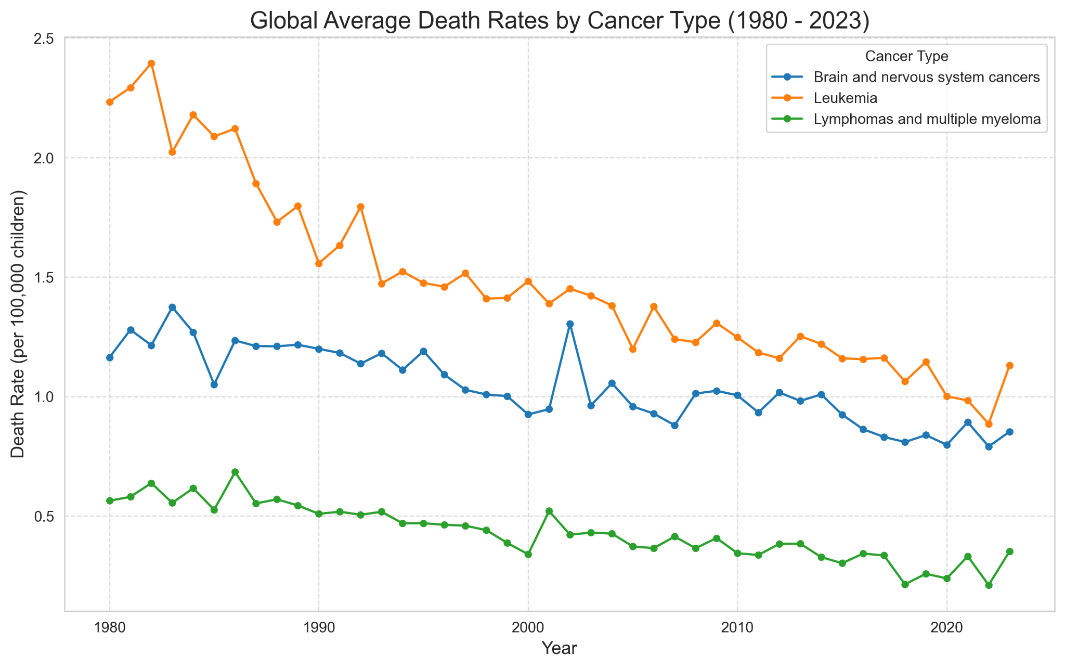
Initial Analysis

Slide 5
Important Considerations
This dataset moreso covers reported cases of cancers thanks to improved research, not necessarily any sudden outbreaks.
According to the CDC, while global leukemia death rates in children have decreased by 47% from 2001 to 2021, global brain cancer death rates in children have only decreased by 11%, and by 2021, it was 23% higher than leukemia death rates.

Slide 6
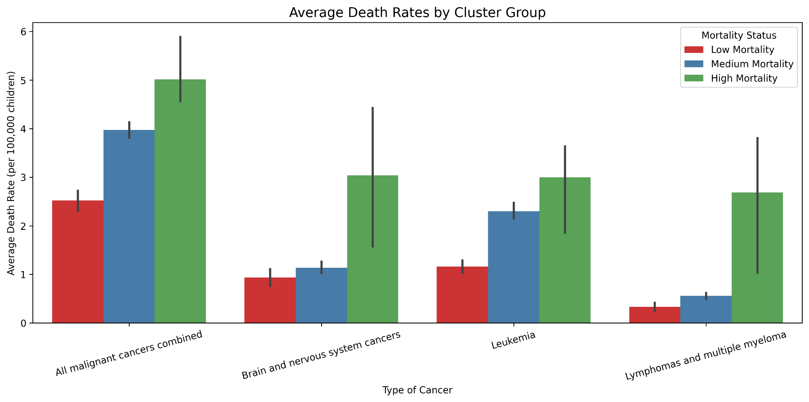
K-means clustering

Slide 7
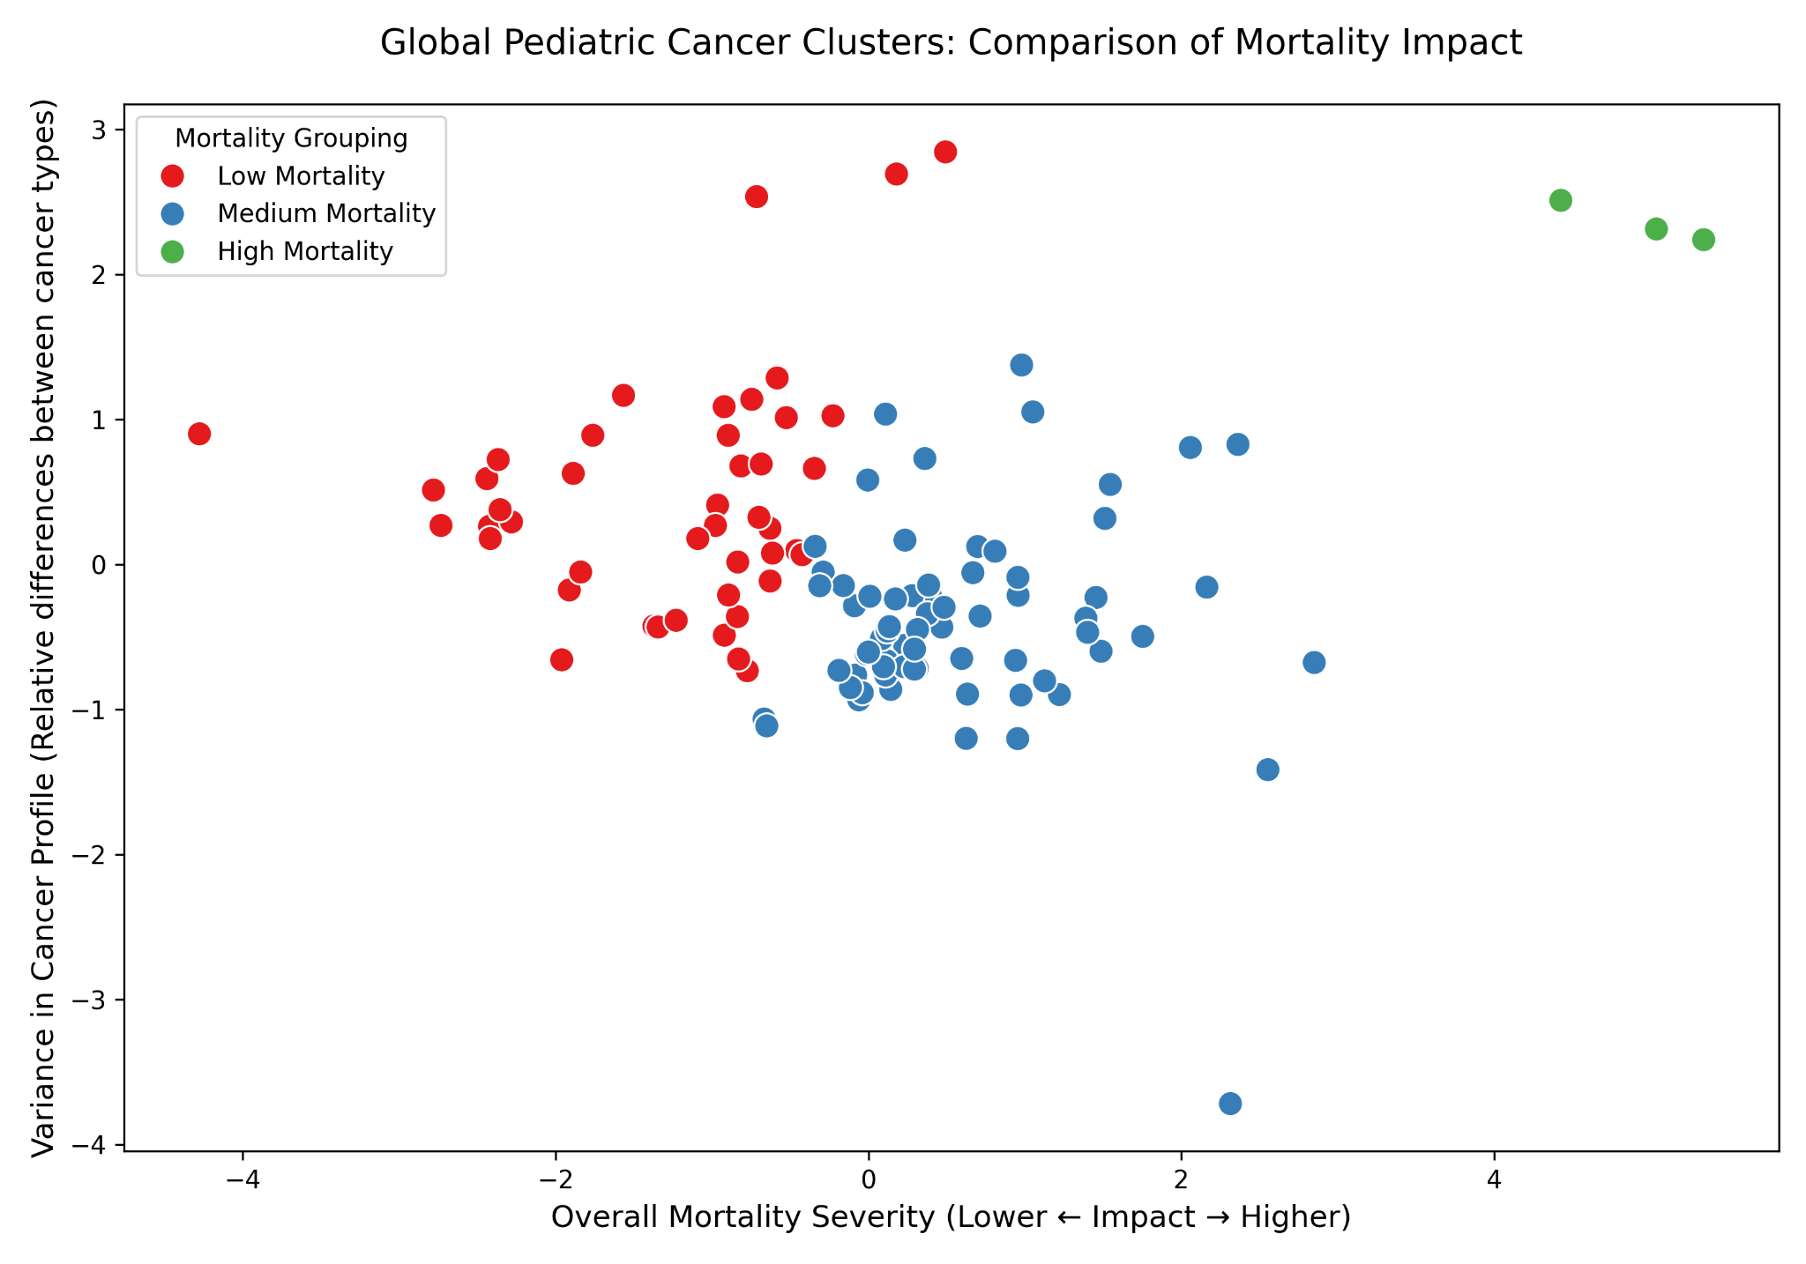
K-means clustering

Slide 8
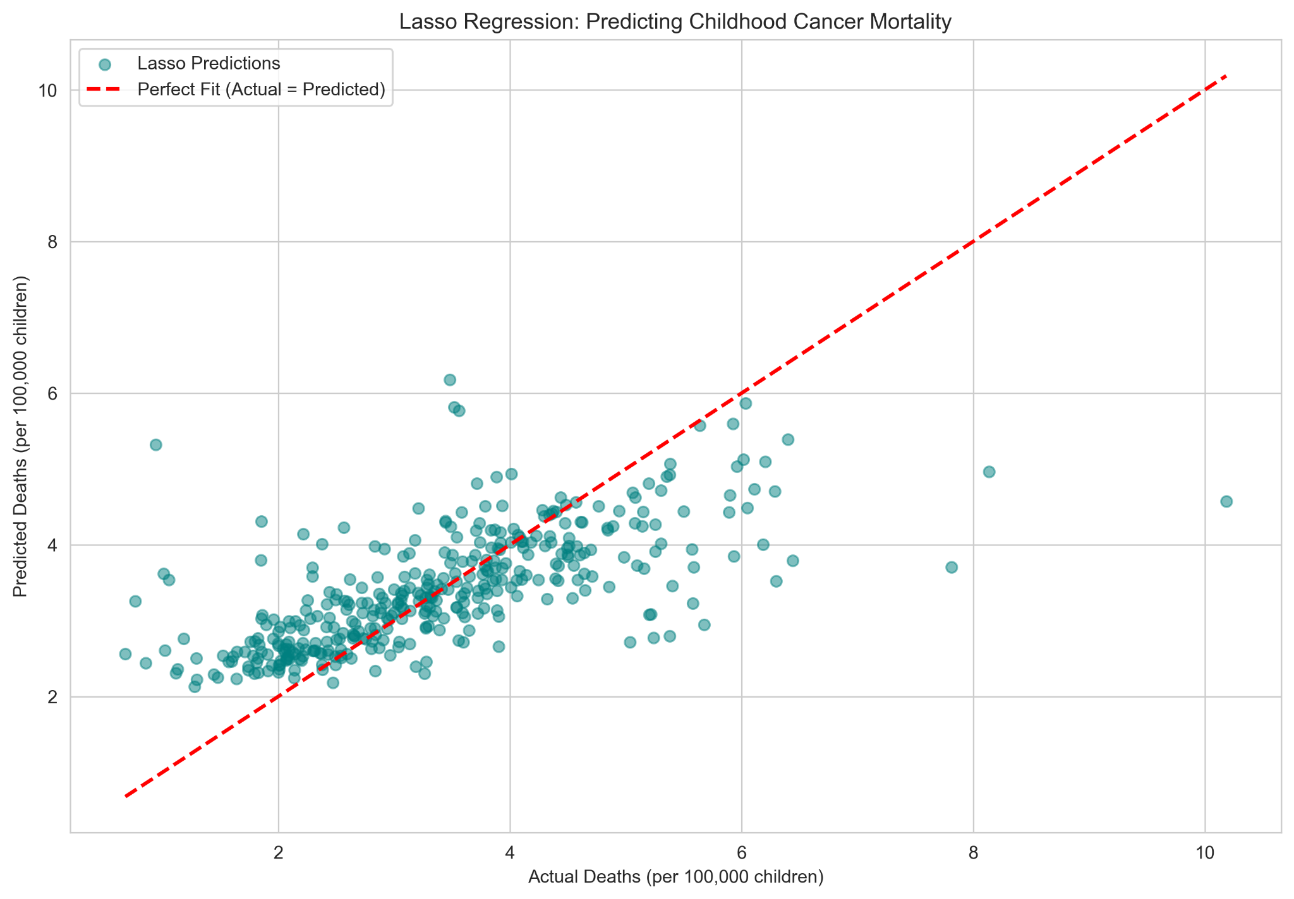
Lasso Regression

Slide 9
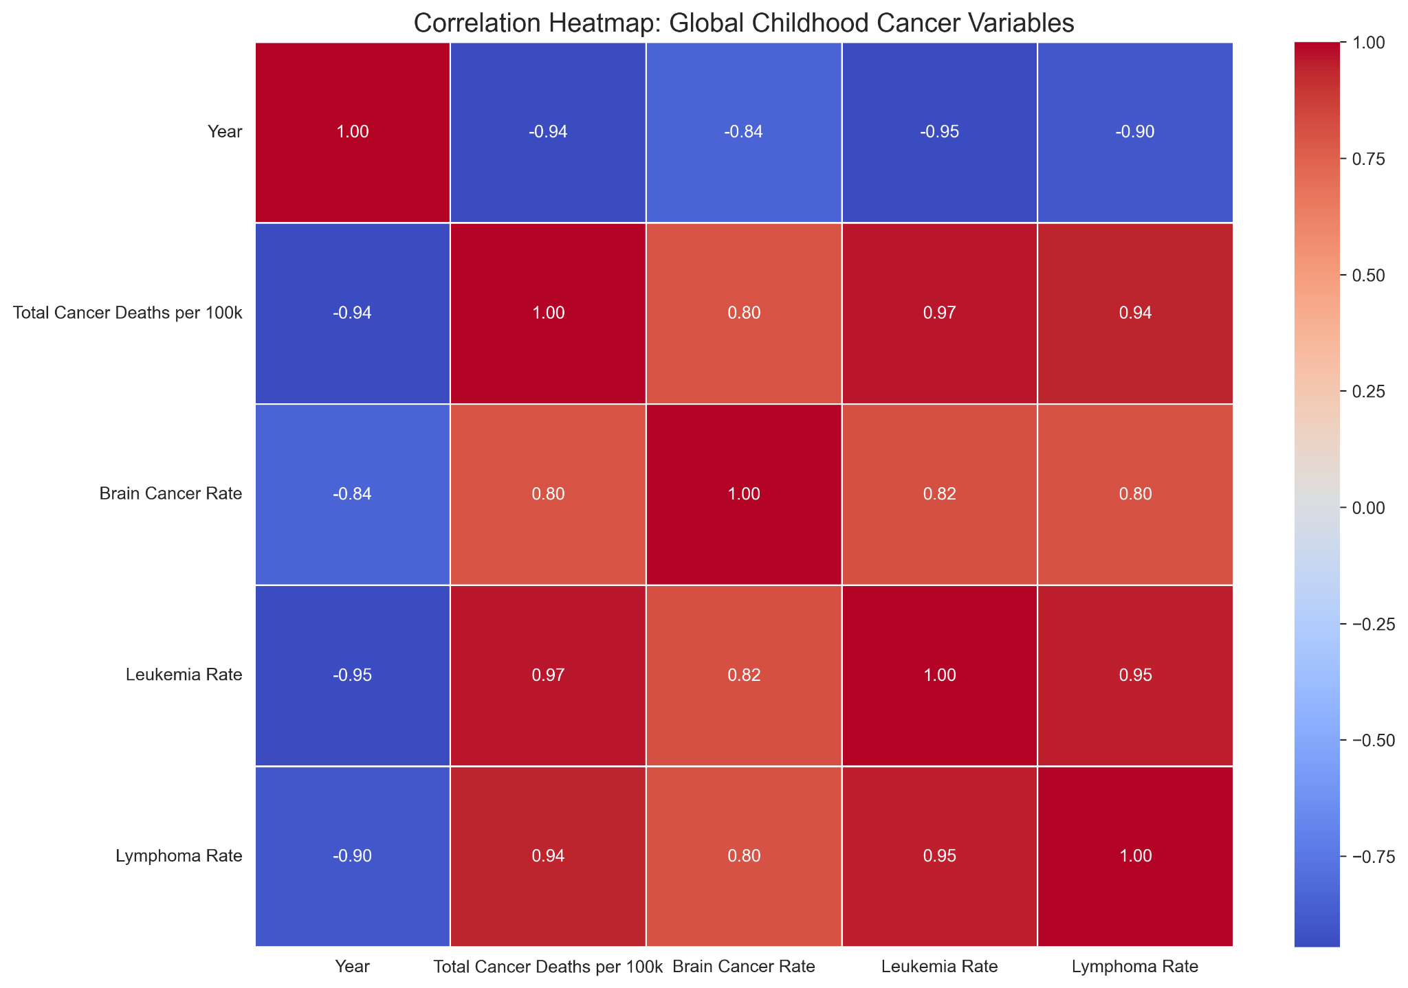
Correlations

Slide 10
How does this vary per country?
Obviously, how each country is able to handle childhood cancer varies greatly, so we’ll use the same methods to compare the death rates across different countries.
We’ll start with countries with higher reported mortality rates.

Slide 11
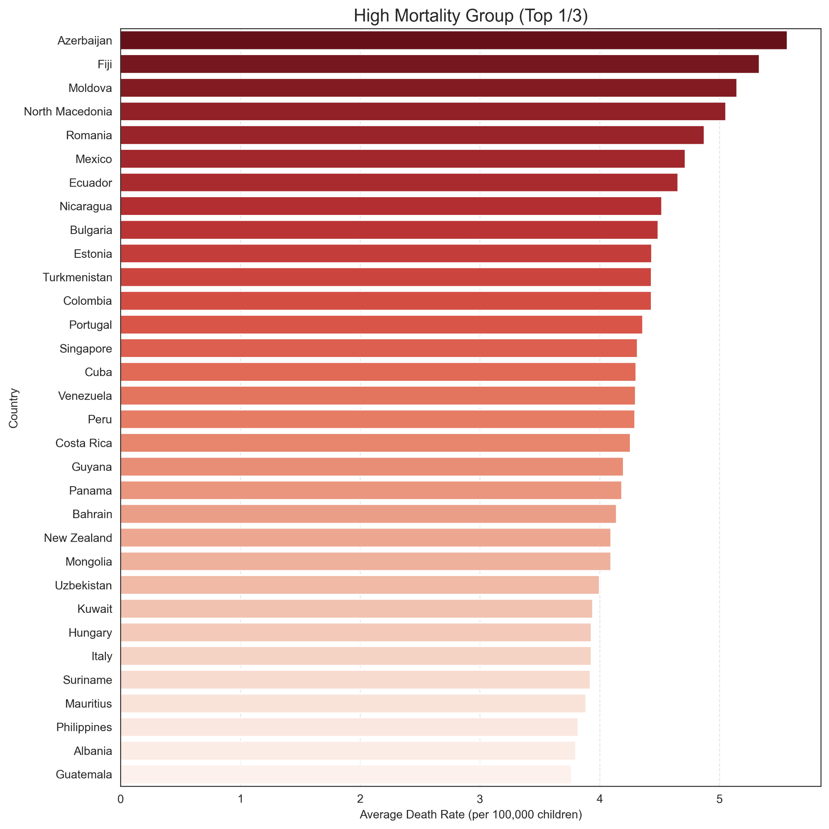
High Mortality Rates (all cancers combined)

Slide 12
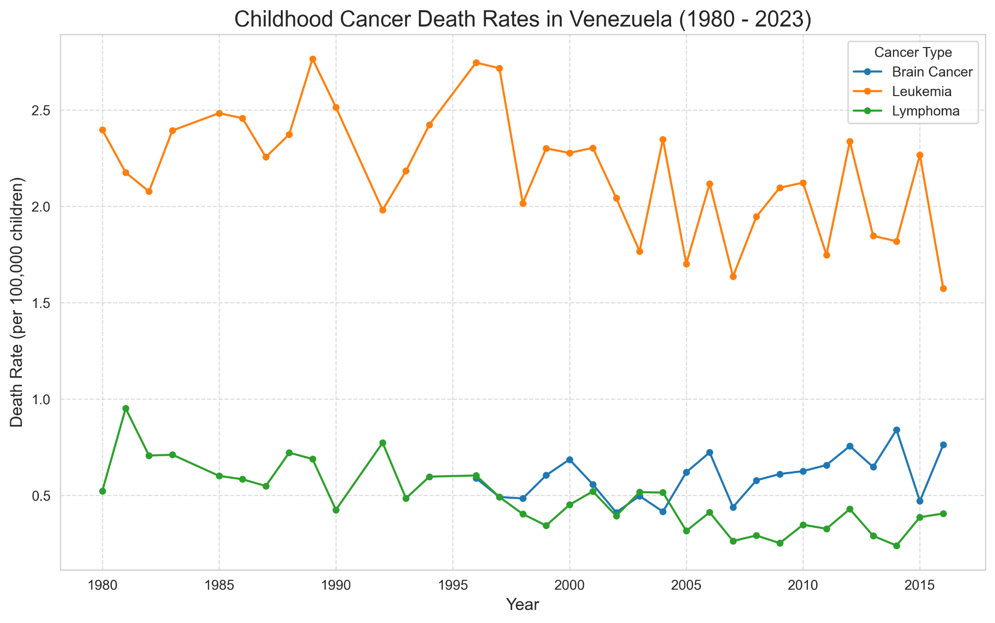
Venezuela Analysis
According to research gathered by the ASCO (American Society of Clinical Ocology), the reason for the sharp increase in mortalities after 2010 is primarily due to a critical shortage of cancer resources at the time,

Slide 13
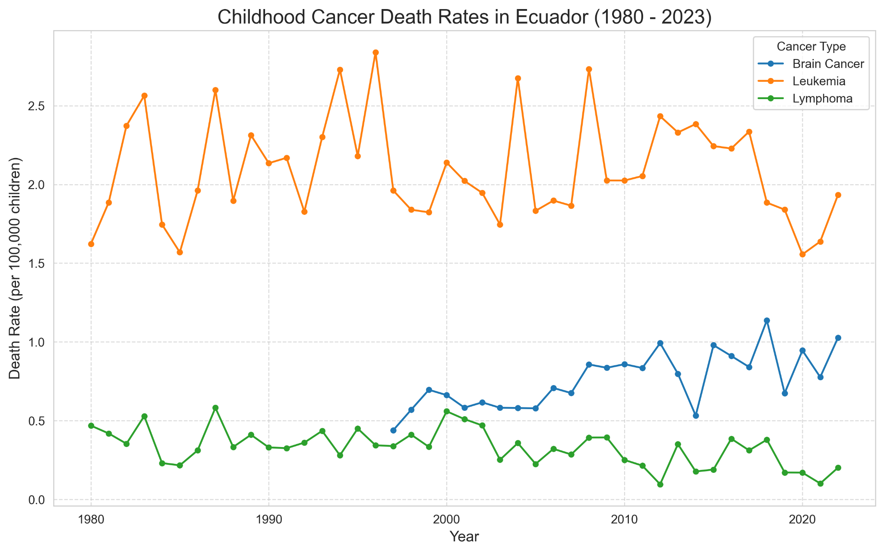
Ecuador Analysis
Ecuador’s constantly shifting mortality rates are also theorized to be caused by significant geographic disparities in access to diagnoses.

Slide 14
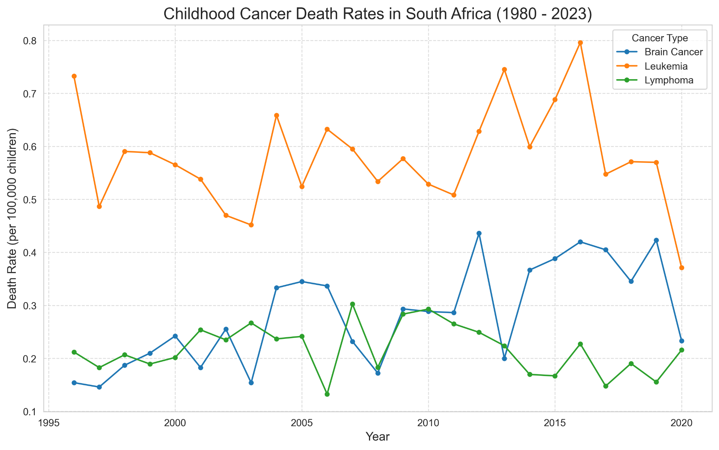
South Africa Analysis
South Africa is different, however, because the large increases in mortalities is largely due to improving research and reports.

Slide 15
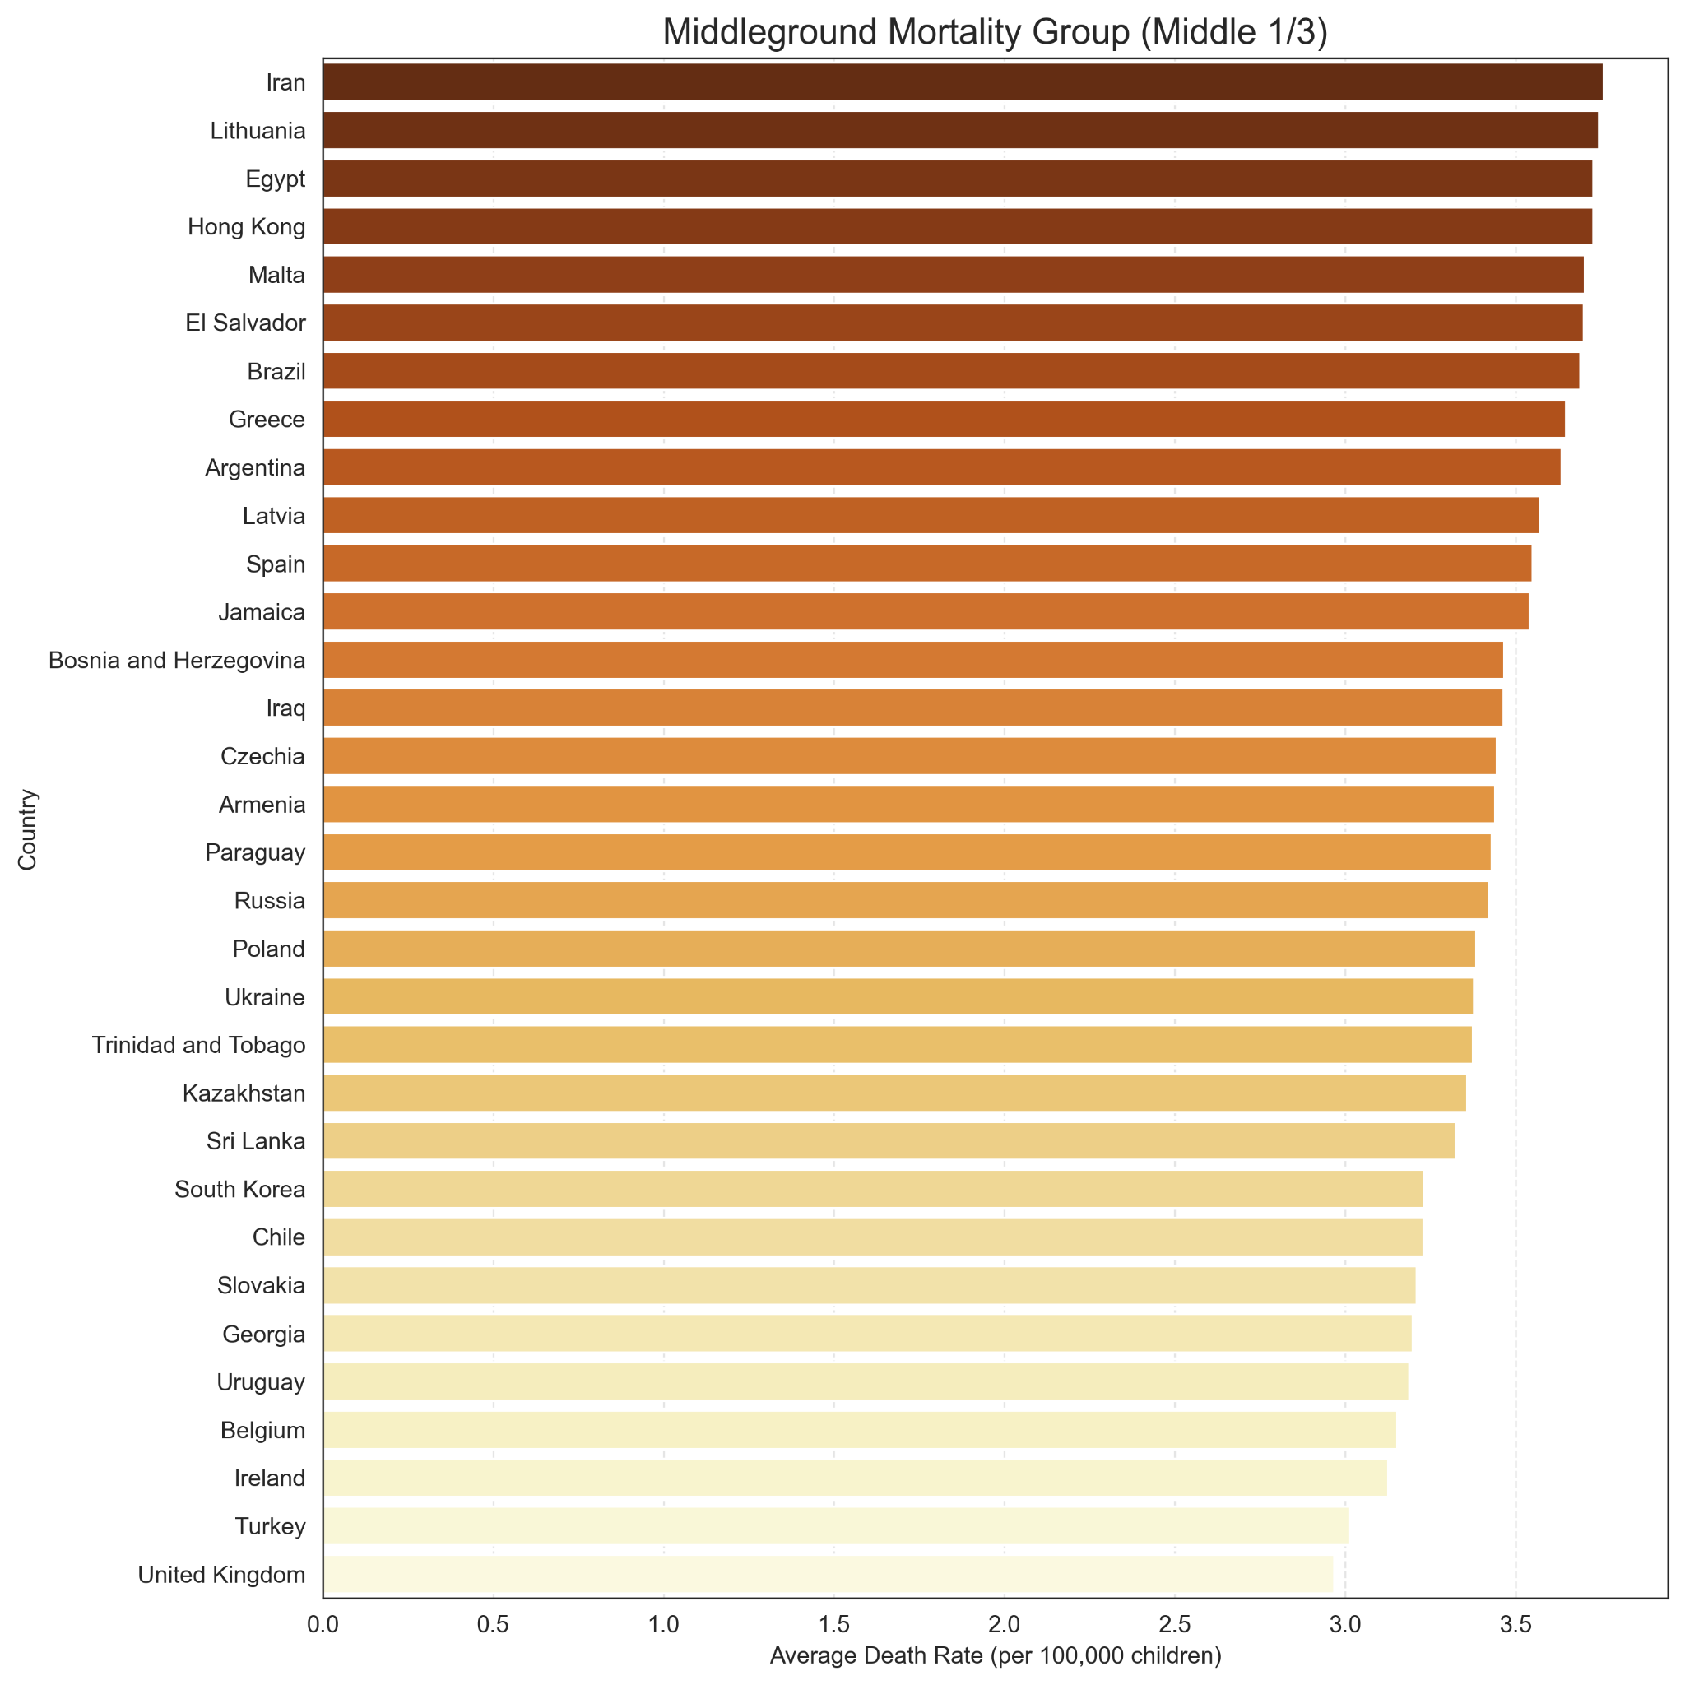
Middleground Mortality Rates (all cancers combined)

Slide 16
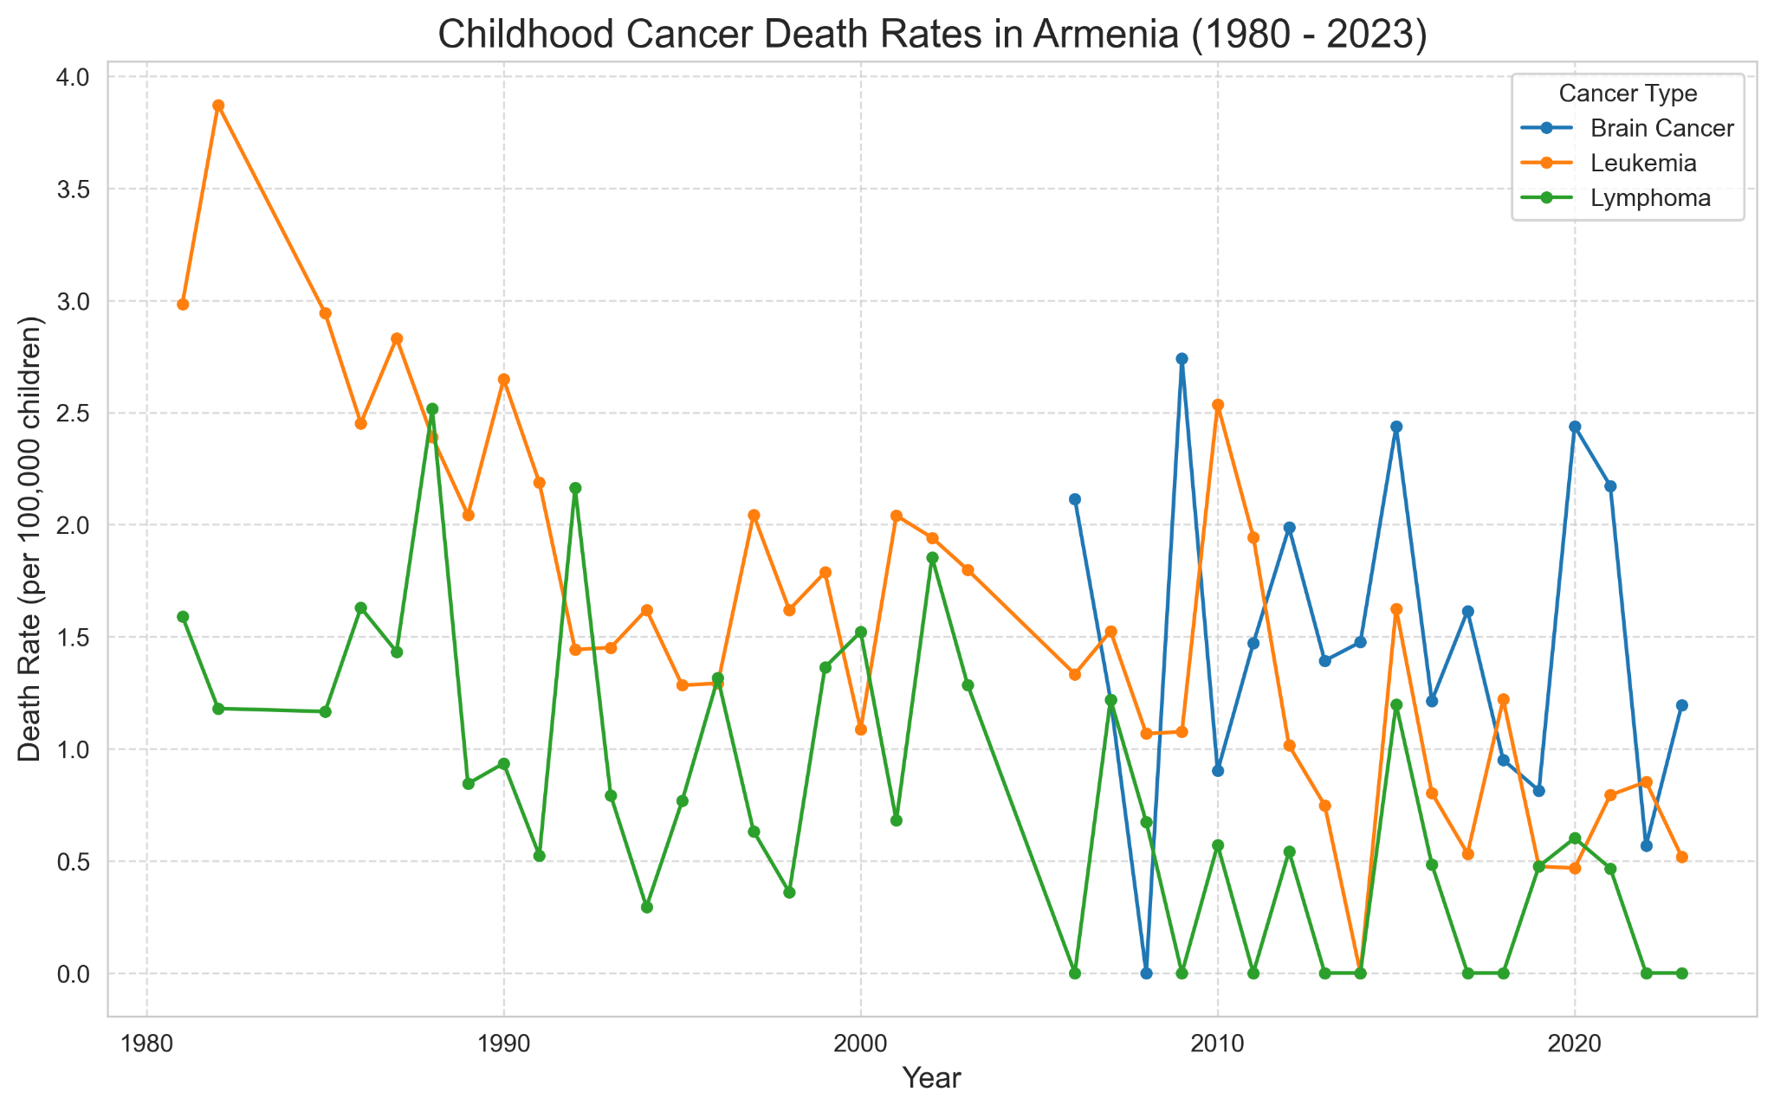
Armenia Analysis
The childhood cancer mortality rates in smaller countries like Armenia have decreased greatly thanks to the Global Initiative for Childhood Cancer and partnerships with St. Jude’s Children’s Hospital, providing better access to diagnoses and treatments.

Slide 17
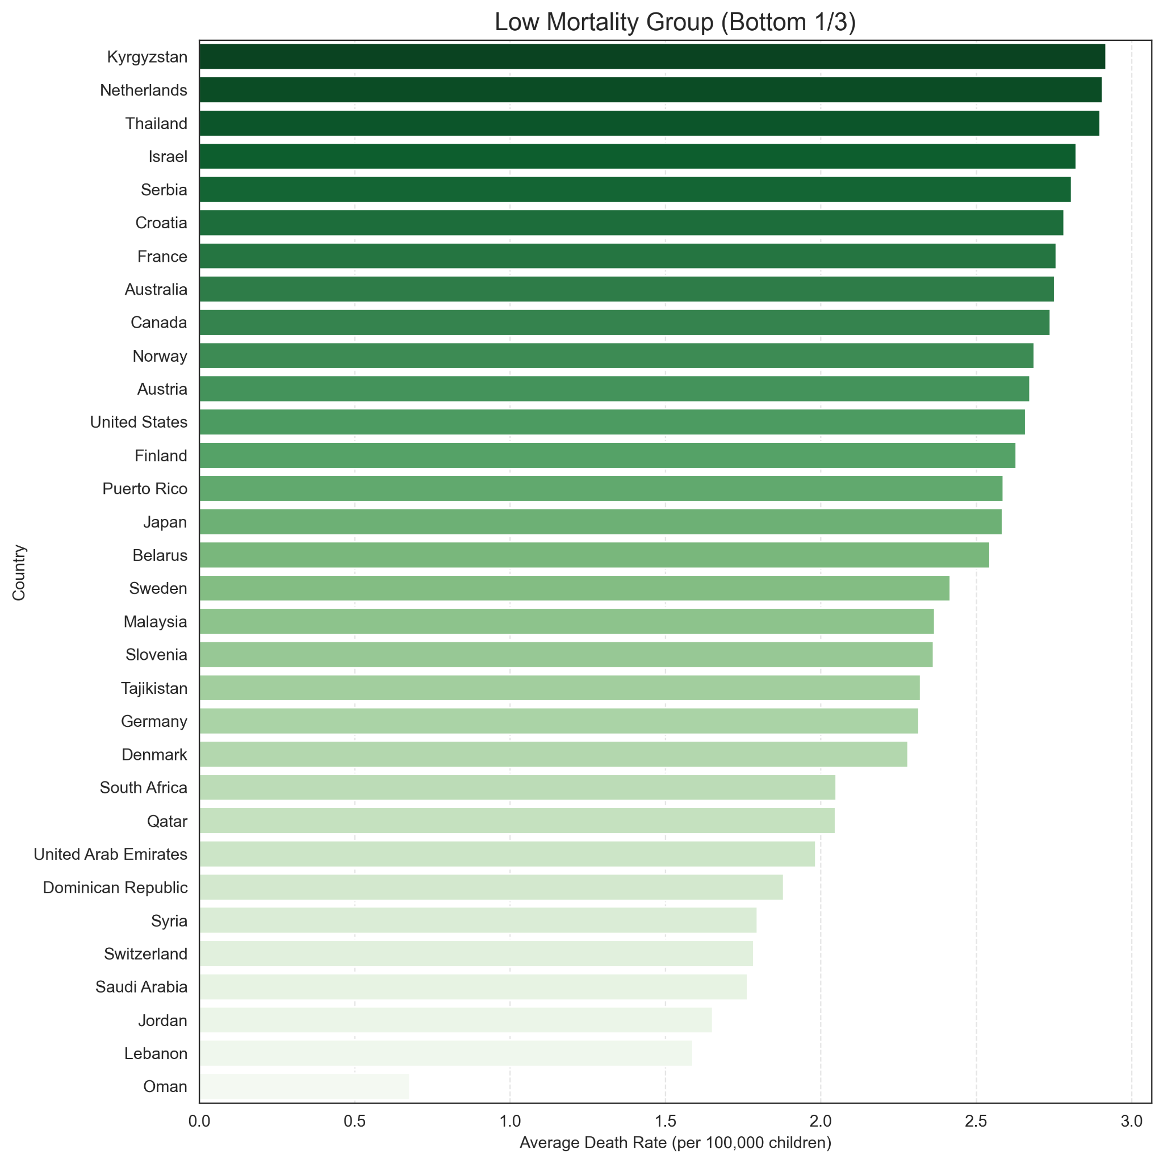
Low Mortality Rates (all cancers combined)

Slide 18
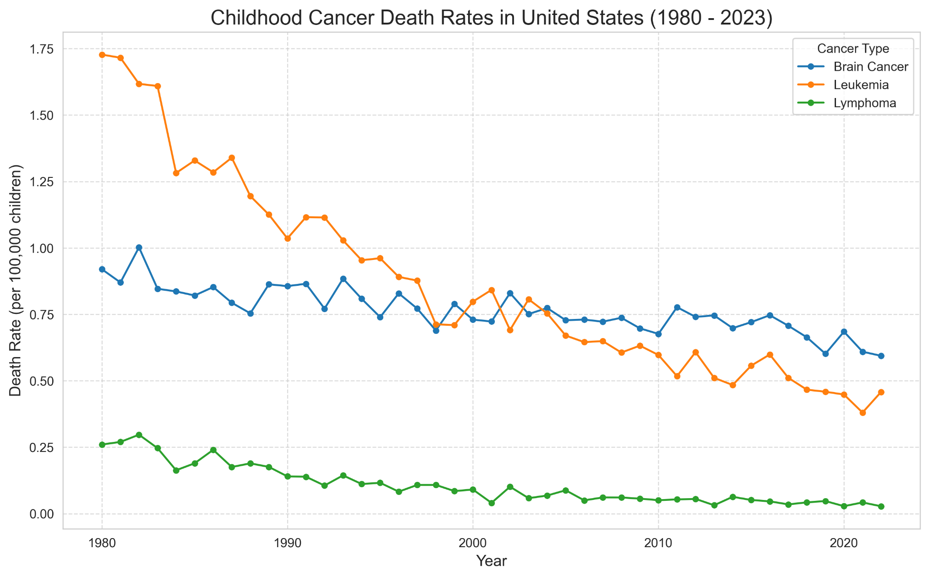
United States Analysis
While treatment and diagnoses have improved dramatically in the United States, we unfortunately run the risk of increases in deaths due to recent budgets to cancer research.

Slide 19
Conclusions and Further Research
These visuals provide a lot of insight as to how certain events, collaborations, and disruptions can have an effect on the rates of childhood cancer mortalities.
Once again, it’s important to acknowledge that this data was of reported deaths.
If more research is to be conducted on this topic, the rates of childhood cancer diagnoses and successful treatments should also be taken into consideration, as well as doing research on the history of individual countries.

Slide 20
Sources
Sally C., Curtin, and Anderson Robert N. “Products - Data Briefs - Number 484 - November 2023.” Www.cdc.gov, 17 Nov. 2023, www.cdc.gov/nchs/products/databriefs/db484.htm.
Duma, N., & Duque Duran, L. (2019). The state of cancer care in Venezuela. Journal of Global Oncology, 1-2. https://doi.org/10.1200/jgo.19.00031
Otoo, M. N., Lubbe, M. S., Steyn, H., & Burger, J. R. (2020). Childhood cancers in a section of the South African private health sector: Analysis of medicines claims data. Health SA Gesondheid, 25. https://doi.org/10.4102/hsag.v25i0.1382
IARC & St Jude Children's Research Hospital. (2026). Building local capacity for childhood cancer registration: Real-world examples. JCO Global Oncology. https://ascopubs.org/doi/abs/10.1200/GO-25-00471
IARC & St Jude Children's Research Hospital. (2026). Building local capacity for childhood cancer registration: Real-world examples. JCO Global Oncology. Link: https://ascopubs.org/doi/abs/10.1200/GO-25-00471
OncLive. (2013, August 16). Federal funding cuts hit cancer research despite public support. https://www.onclive.com/view/federal-funding-cuts-hit-cancer-research-despite-public-support

